Slide 1




University Institute of Engineering
Department of Computer Science & Engineering
COMPUTER ORGANIZATION & ARCHITECTURE
(23CST-204/23ITT-204)
ER. SHIKHA ATWAL
E11186
ASSISTANT PROFESSOR
BE-CSE

Slide 2
MEMORY SUBSYSTEM ORGANIZATION
Memory is the group of circuits used to store data.
Memory components have some number of memory locations, each word of which stores a binary value of some fixed length.
The number of locations and the size of each location vary from memory chip to memory chip, but they are fixed within individual chip.
The size of the memory chip is denoted as the number of locations times the number of bits in each location. For example, a memory chip of size 512×8 has 512 memory locations, each of which has eight bits.
The address inputs of a memory chip choose one of its locations. A memory chip with 2^{n} locations requires n address inputs.

Slide 3
MEMORY SUBSYSTEM ORGANIZATION
View the memory unit as a black box. Data transfer between the memory and the processor takes place through the use of two registers called MAR (Memory Address Register) and MDR (Memory data register).
MAR is n-bits long and MDR is m-bits long, and data is transferred between the memory and the processor. This transfer takes place over the processor bus.

Slide 4
MEMORY HIERARCHY
A memory system is a hierarchy of storage devices with different capacities, costs, and access times.
CPU registers hold the most frequently used data.
Small, fast cache memories nearby the CPU act as staging areas for a subset of the data and instructions stored in the relatively slow main memory.
Memory is categorized into volatile and non-volatile memories, with the former requiring constant power ON of the system to maintain data storage.
Furthermore, a typical computer system provides a hierarchy of different times of memories for data storage.

Slide 5
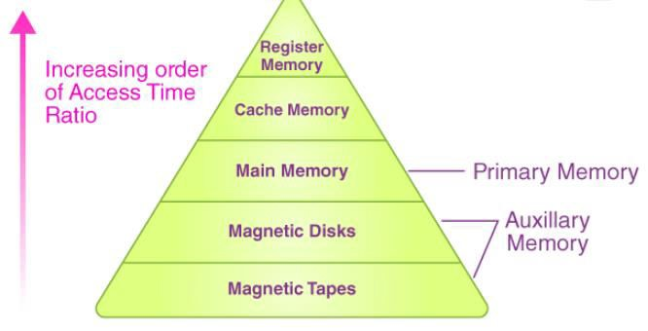
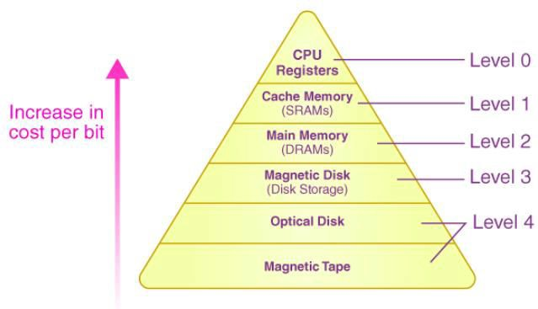
Hierarchy of Memory

Slide 6
This Hierarchy Design of Memory is divided into two main types. They are:
External or Secondary Memory: It consists of Magnetic Tape, Optical Disk, Magnetic Disk i.e., it includes peripheral storage devices that are accessible by the system’s processor via I/O Module.
Internal Memory or Primary Memory: It consists of CPU registers, Cache Memory, and Main Memory. It is accessible directly by the processor.

Slide 7
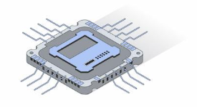
In computers, the memory hierarchy primarily includes the following:
Registers
The register is usually an SRAM or static RAM in the computer processor that is used to hold the data word that is typically 64 bits or 128 bits. A majority of the processors make use of a status word register and an accumulator. The accumulator is primarily used to store the data in the form of mathematical operations, and the status word register is primarily used for decision making.

Slide 8
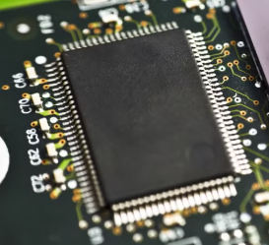
Cache Memory
The cache basically holds a chunk of information that is used frequently from the main memory. We can also find cache memory in the processor. In case the processor has a single- core, it will rarely have multiple cache levels. The present multi-core processors would have three 2-levels for every individual core, and one of the levels is shared.

Slide 9
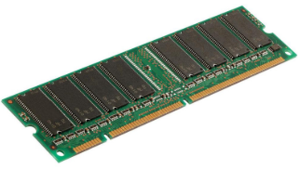
Main Memory
In a computer, the main memory is nothing but the CPU’s memory unit that communicates directly. It’s the primary storage unit of a computer system. The main memory is very fast and a very large memory that is used for storing the information throughout the computer’s operations. This type of memory is made up of ROM as well as RAM.

Slide 10
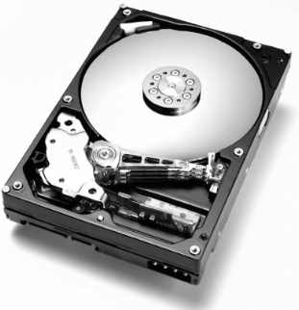
Magnetic Disks
In a computer, the magnetic disks are circular plates that’s fabricated with plastic or metal with a magnetised material. Two faces of a disk are frequently used, and many disks can be stacked on a single spindle by read/write heads that are obtainable on every plane. The disks in a computer jointly turn at high speed.

Slide 11
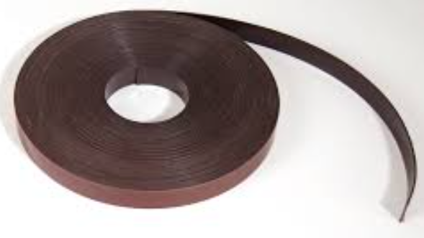
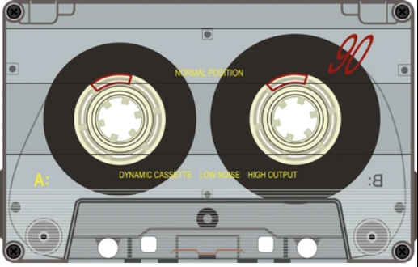
5. Magnetic Tape
Magnetic tape refers to a normal magnetic recording designed with a slender magnetizable overlay that covers an extended, thin strip of plastic film. It is used mainly to back up huge chunks of data. When a computer needs to access a strip, it will first mount it to access the information. Once the information is allowed, it will then be unmounted. The actual access time of a computer memory would be slower within a magnetic strip, and it will take a few minutes for us to access a strip.

Slide 12
Characteristics of Memory Hierarchy
One can infer these characteristics of a Memory Hierarchy Design from the figure given above:
Capacity: It refers to the total volume of data that a system’s memory can store. The capacity increases moving from the top to the bottom in the Memory Hierarchy.
Access Time: It refers to the time interval present between the request for read/write and the data availability. The access time increases as we move from the top to the bottom in the Memory Hierarchy.

Slide 13
Characteristics of Memory Hierarchy
3. Performance: When a computer system was designed earlier without the Memory Hierarchy Design, the gap in speed increased between the given CPU registers and the Main Memory due to a large difference in the system’s access time. It ultimately resulted in the system’s lower performance, and thus, enhancement was required. Such a kind of enhancement was introduced in the form of Memory Hierarchy Design, and because of this, the system’s performance increased. One of the primary ways to increase the performance of a system is minimising how much a memory hierarchy has to be done to manipulate data.
4. Cost per bit: The cost per bit increases as one moves from the bottom to the top in the Memory Hierarchy, i.e. External Memory is cheaper than Internal Memory.

Slide 14
Data movement
In order to perform computation, data must travel from the secondary storage to the CPU. Due to the vast differences in access speed and storage capacity, the operating system performs a series of sophisticated steps (both at the levels of hardware and the software).
The data transfer speed (from memory to hard drive or vice versa) depends on:
Contiguousness of the accessed physical locations on the disk
The size of the accessed data per request

Slide 15
Characteristics of Memory in Computer
The following are the characteristics of memory in computer:
The storage capacity varies for different types of memories in computers. The storage capacity of external devices is measured in bytes, while internal memory is measured either in words or bytes. Storage word length may vary in 8, 16, or 32 bits.
Unit of transfer measures the transfer rate of bits that can be either read or written in and out of memory devices. This data transfer rate is different in internal and external devices. For internal memory, it is usually equal to word size and for external memory, it is greater than a word.
The internal memory in a computer is built within it, whereas external memory is present as a separate storage device such as USB or disk.

Slide 16
Characteristics of Memory in Computer
The following are the characteristics of memory in computer:
There are four methods to access memory, including DMA, Associative Access Method, Sequential Access Method, and Random Access Method.
Memory in computers has different physical behavior, such as volatile, non-erasable, and non-volatile memory.
The performance of the memory depends on access time, memory cycle time and transfer rate. Access time is the total time taken by memory devices to perform read and write operations.
Memory cycle time is the total time needed to access the memory block and the additional time needed before starting the second access.

Slide 17
References
Reference Books:
J.P. Hayes, “Computer Architecture and Organization”, Third Edition.
Mano, M., “Computer System Architecture”, Third Edition, Prentice Hall.
Stallings, W., “Computer Organization and Architecture”, Eighth Edition, Pearson Education.
Text Books:
Carpinelli J.D,” Computer systems organization &Architecture”, Fourth Edition, Addison Wesley.
Patterson and Hennessy, “Computer Architecture”, Fifth Edition Morgaon Kauffman.

Slide 18
Other References
http://cms.gcg11.ac.in/attachments/article/93/Memory%20Organization.pdf
https://www.slideshare.net/ishapadhy/memory-organization-73277070
https://upscfever.com/upsc-fever/en/gatecse/en-gatecse-chp166.html
Video References
https://www.youtube.com/watch?v=dCn9eGN9YvM

